Slide 1

KICK START
Hello everyone we are from Siddhartha Institute of Engineering and Technology.
In the below ppt we have explain about KICK START (Job Portal Website).
WE are four member in our team,
Ms. K. Varsha
Mr. K. Sowrabh
Mr. M. Gopi
Mr. A. Sai Charan
About
About

Slide 2
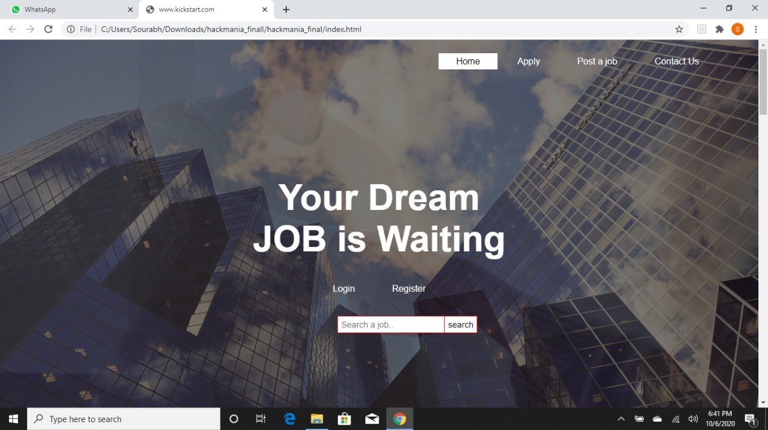
HOME
This is the landing page of our webpage Kick Start
As you can see in the home page we have :
Apply
Post a Job
Contact Us
In the home page we can login and register to our website.
You can also see a search bar where we can search for the required categories.
We can also see how many Students, Organizers and Companies are connected with us.
About
Home

Slide 3
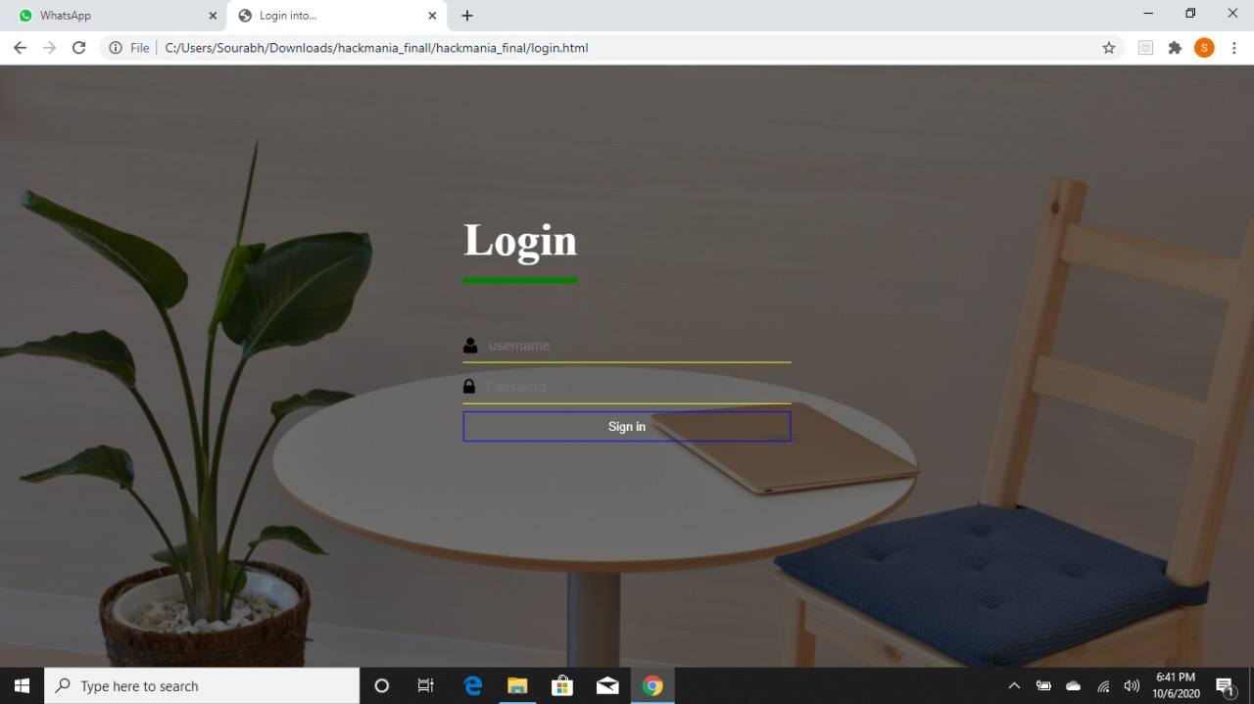
LOGIN
By clicking on the login button you will land on this Login page.
From here login page Students ,Organizers, Companies can login to their profiles.
About
Login

Slide 4
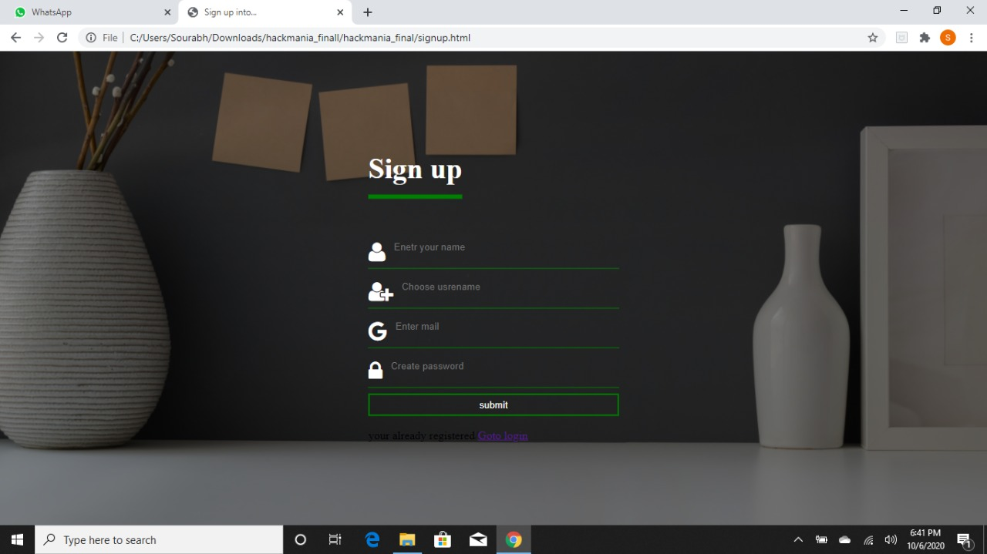
RIGISTER
From here Students, Organizers ,Companies etc can register in our website by filling the below form.
About
Register

Slide 5
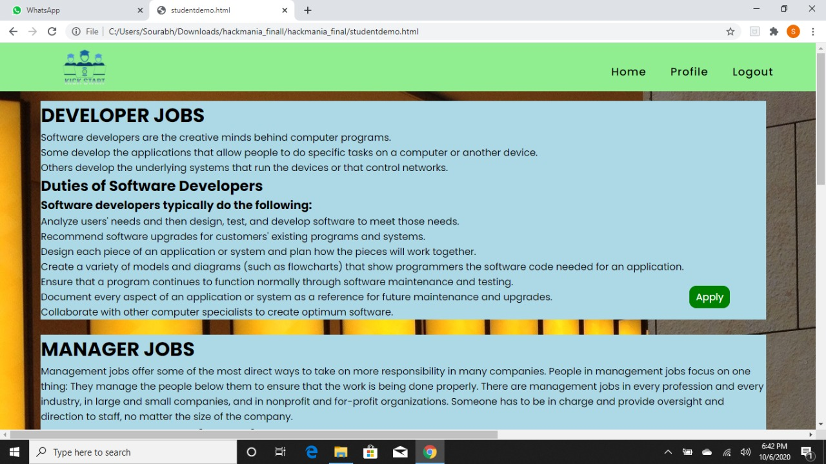
Apply
By clicking on the apply menu. You will land on the apply page
As you can see ,
Here you can apply for your desired jobs and start your journey in the Professional Industry.
About
Apply

Slide 6
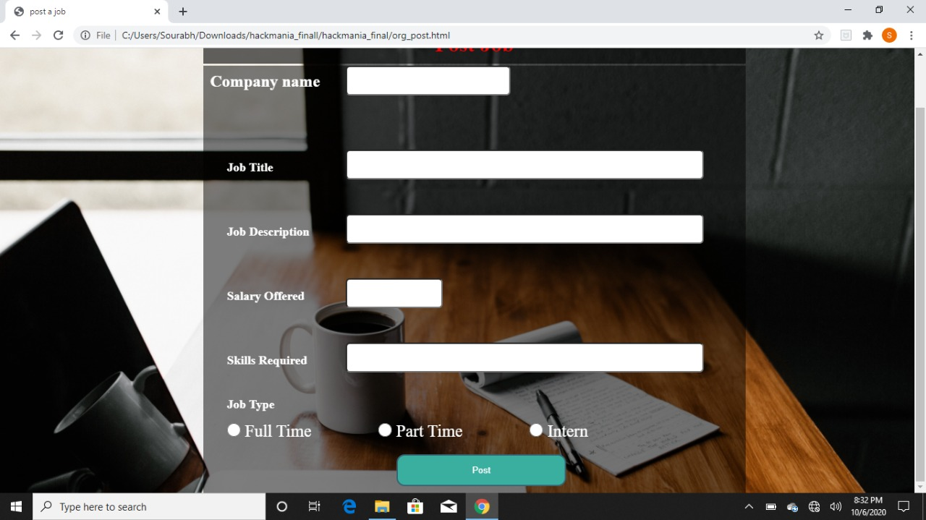
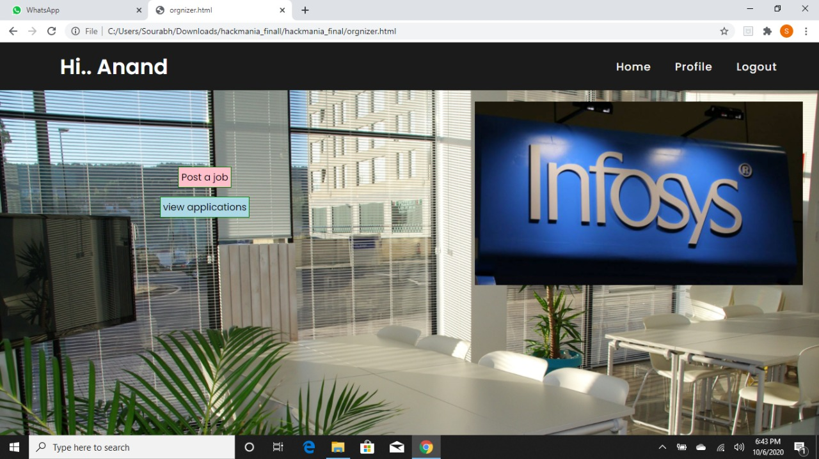
POST A JOB
As we can see , From here recruiters, job organizers or any company can post a job.
When you click on post job you will land on the following page where companies can fill the following form and post it.
About
Post a job

Slide 7
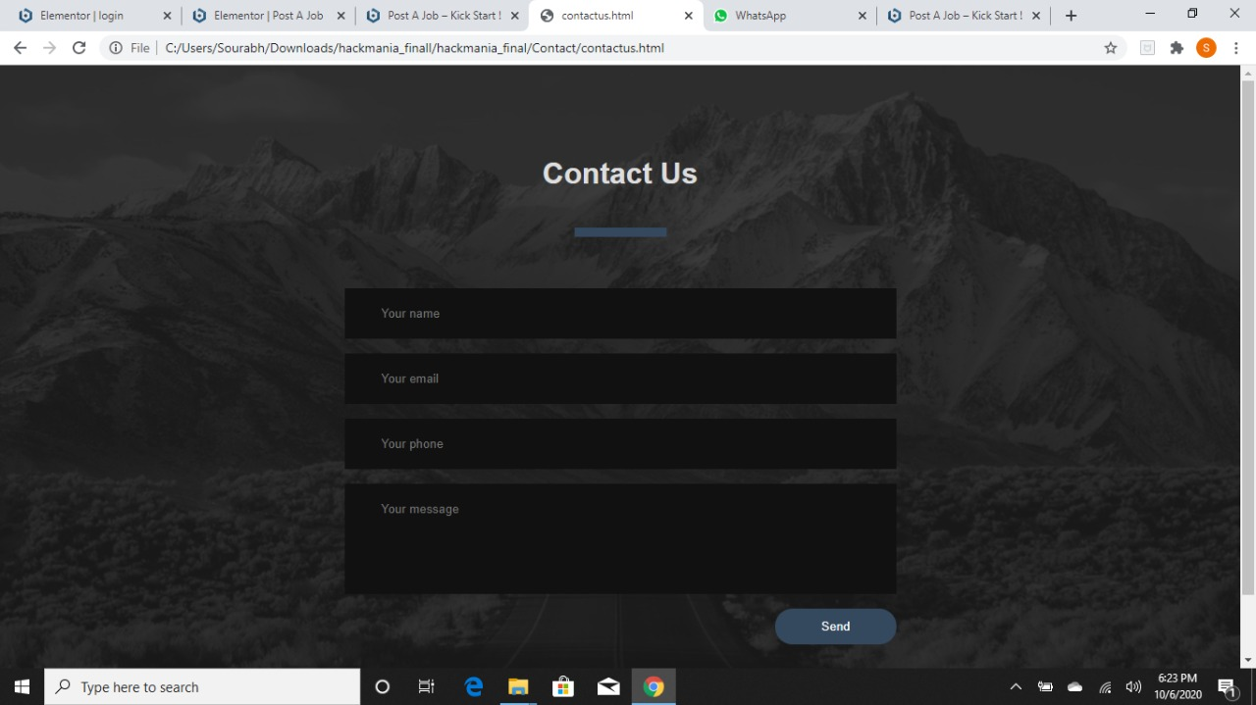
CONTACT US
As you can see here that our customers can fill the following form and stay connected with us.
We provide our customers with the best services 24/7.
About
Contact

